Slide 1

TITLE: COMMUNITY- SYNC FOR DIGITAL COLLABRATION
Student Name: Harshitha Bollineni
Student ID: 2520080007 - AI DS
Cluster:4
Section:15
Under the Guidance
of
Supervisor Name: Dr . Jayaram Boga
Assistant Professor
Department of CSE

Slide 2
OUTLINE
Abstract
Existing System
Proposed System
System Architecture
Project Modules
Objectives
Co’s Attainments - FWD
Co1
Co2 …….. 5. Co5
Co’s Attainments - DSA
Co1
Co2 …….. 5. Co5
Screen Shots for FWD & DSA
Conclusion
Geo-Tagged Photos

Slide 3
Abstract
Community-Sync A Modern Digital Collaboration Platform for Community Engagement:
Community-Sync is a modern digital collaboration platform designed to enhance community engagement through seamless communication and coordination. It brings together tools for real-time interaction, content sharing, event management, and feedback collection in one unified system. The platform supports collaboration among individuals, organizations, and community leaders. Its user-centered design ensures ease of use and accessibility. Scalable cloud-based infrastructure allows it to adapt to different community sizes. CommunitySync helps reduce information gaps and improves transparency
Modern Digital Collaboration Platform for Community Engagement

Slide 4
The platform promotes inclusivity and sustained participation through secure and customizable features. Built-in analytics provide insights into engagement patterns and community needs. These insights support informed decision-making and strategic planning. CommunitySync strengthens trust among participants by encouraging open dialogue. It enables collaborative problem-solving across diverse groups. Ultimately, the platform supports long-term community growth and digital empowerment.

Slide 5
Existing System
In many communities, communication and coordination are handled through separate platforms such as social media, messaging apps, and emails.
These systems are not centralized, which often leads to information gaps and poor coordination among members.
Event updates, announcements, and feedback are scattered across different channels, making it difficult for users to stay informed.
The lack of integrated tools reduces transparency and limits effective community participation.

Slide 6
Proposed System
The proposed system, CommunitySync, provides a unified digital platform for community collaboration and engagement.
It integrates features such as real-time communication, event management, content sharing, and feedback collection in one system.
The platform is designed with a user-friendly interface to ensure accessibility for all community members.
By centralizing communication and collaboration tools, CommunitySync improves transparency, participation, and decision-making within communities.

Slide 7
System Architecture
The system follows a three-layer architecture consisting of the presentation layer, application layer, and data layer.
The presentation layer provides the user interface where members can interact with the platform.
The application layer processes user requests and manages functionalities such as messaging, event management, and analytics.
The data layer securely stores user information, event details, and feedback data in a database.
Cloud-based infrastructure ensures scalability, reliability, and secure access for all users.

Slide 8
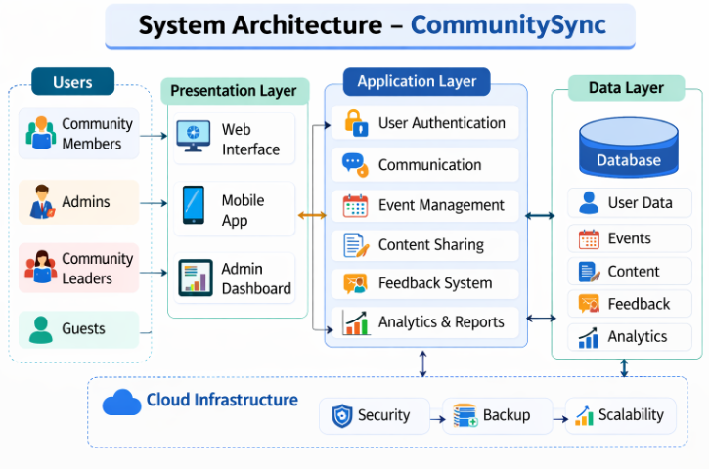
System Architecture

Slide 9
Project Modules
1. User Management Module Handles user registration, login, profile management, and role-based access for members, leaders, and administrators.
2. Communication Module Enables real-time interaction, announcements, and discussions among community members.
3. Event Management Module Allows users to create, manage, and view community events and activities.
4. Content & Feedback Module Supports sharing of posts, documents, and collecting feedback or suggestions from users.
5. Analytics & Security Module Provides engagement reports, data analysis, and ensures secure access and data protection

Slide 10
Objectives
To develop a unified digital platform that improves communication and collaboration within communities.
To provide tools for event management and content sharing to keep community members informed and engaged.
To enable real-time interaction and feedback collection for better participation and communication.
To analyze community engagement through analytics to support informed decision-making.
To ensure a secure, scalable, and user-friendly system that supports long-term community growth.

Slide 11
Co’s Attainments - FWD
CO1: Understanding HTML structure and CSS styling.
CO2: Designing responsive layouts using CSS.
CO3: Implementing JavaScript logic and functions.
CO4: Using DOM manipulation for dynamic content.
CO5: Building complete interactive web applications.

Slide 12
Co’s Attainments - DSA
CO Attainments – DSA
CO1 – Searching & Sorting: Attained by implementing Binary Search O(log n) to find events by ID and Merge Sort O(n log n) to alphabetically sort events and attendees, demonstrating algorithm analysis and divide-and-conquer strategy.
CO2 – Lists: Attained by building a custom Singly Linked List (PersonList) to store registered attendees per event, demonstrating List ADT, node traversal, linear search for duplicate detection, and dynamic data management.
CO3 – Stacks & Queues: Attained by implementing a Linked Stack (ActionStack) for LIFO-based undo logging and a Linked Queue (WaitlistQueue) for FIFO-based waitlist management when events reach full capacity.
CO4 – Hashing & Trees: Attained by implementing a Hash Table with Separate Chaining (EventHashTable) for O(1) average event storage and retrieval, and a Binary Min-Heap (PriorityBoardingHeap) for priority-based boarding order with VIP-first extraction.

Slide 13
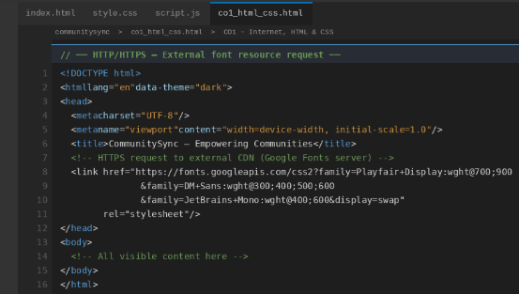
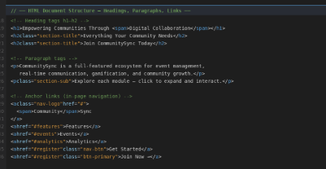
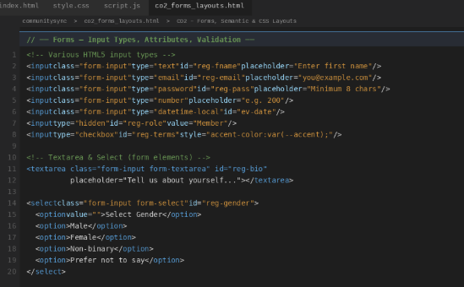
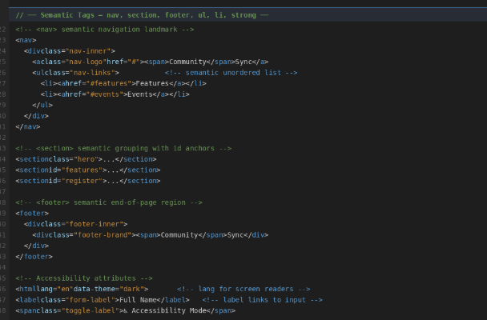
Screenshots for FWD
CO1 – HTML Structure & Basic CSS
CO2 – HTML Forms & Input Handling

Slide 14
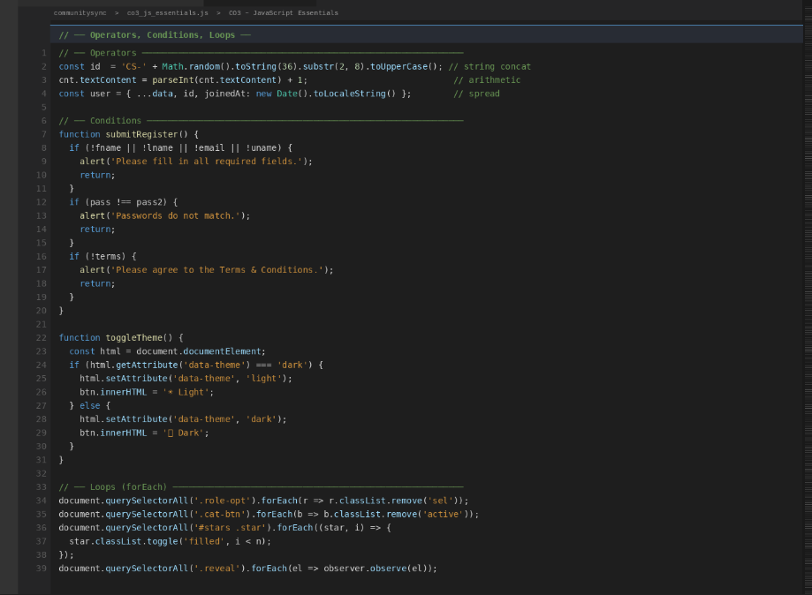
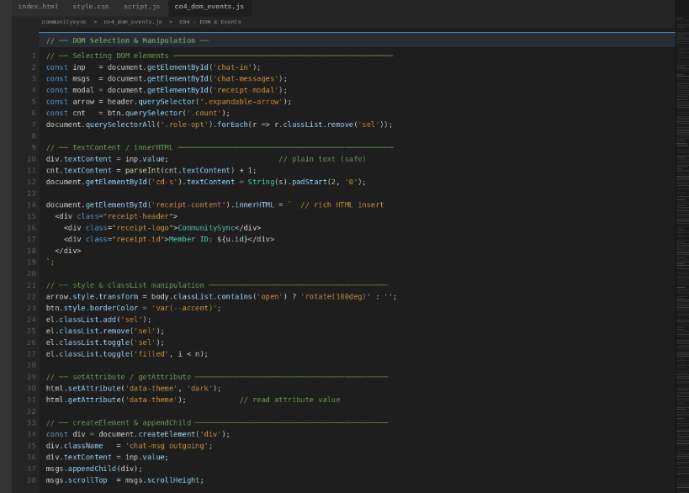
Screenshots for FWD
CO3 – JavaScript Programming Concepts
CO4 – JavaScript DOM Manipulation

Slide 15
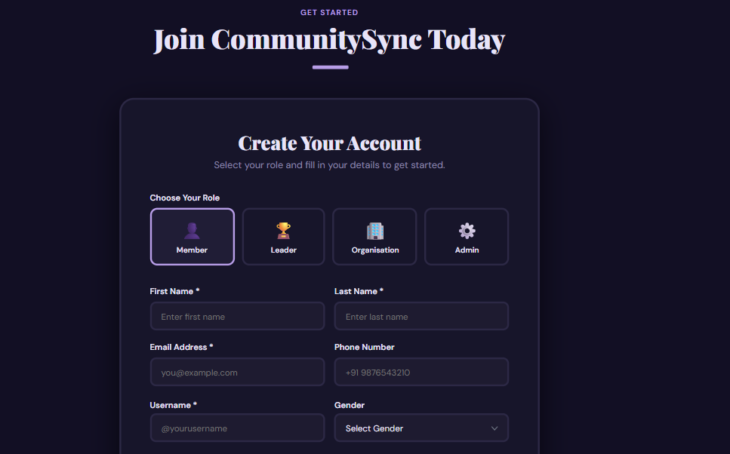
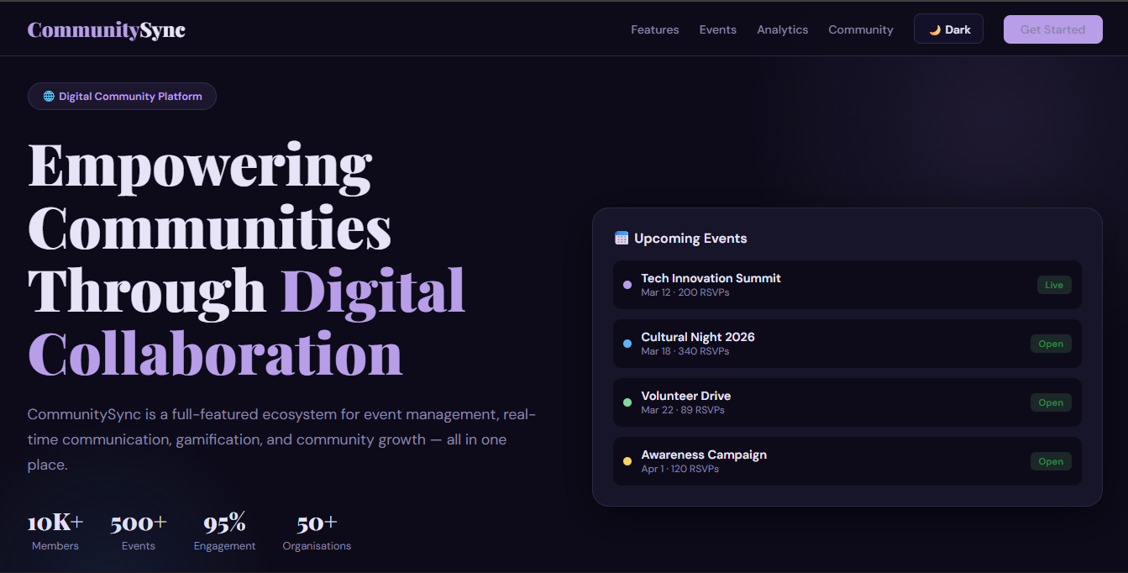
Screenshots for FWD
CO5 – Advanced Web Application Features

Slide 16
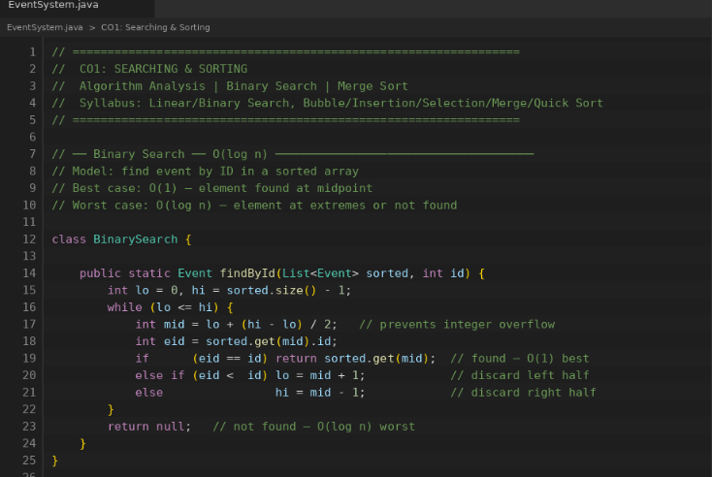
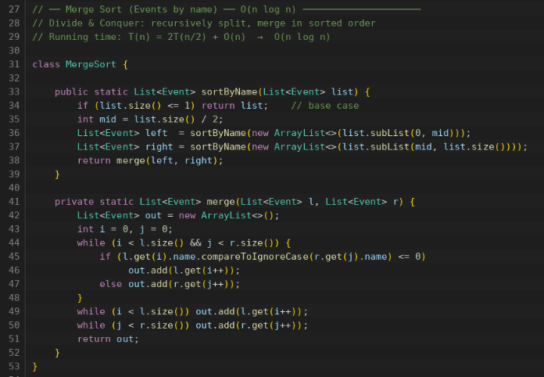
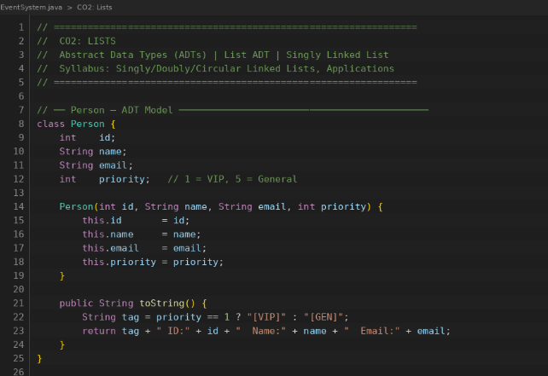
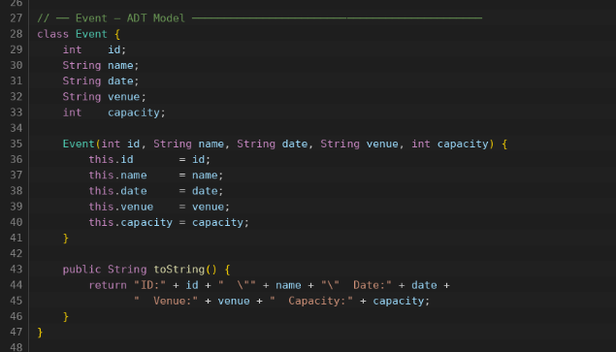
Screenshots for DSA
CO1 – Algorithm Implementation (Searching / Efficiency Concept)
CO2 – ADT using ArrayList

Slide 17
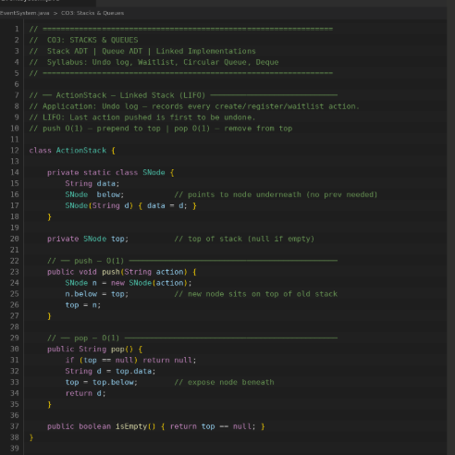
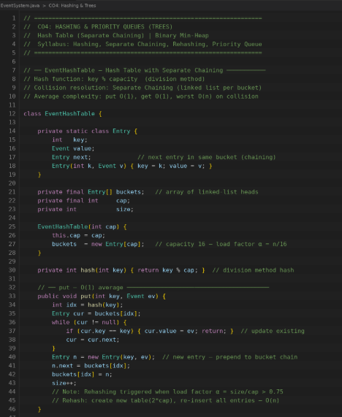
Screenshots for DSA
CO3 – Linear Data Structure Operations
CO4 – Hash-Based Data Structures

Slide 18
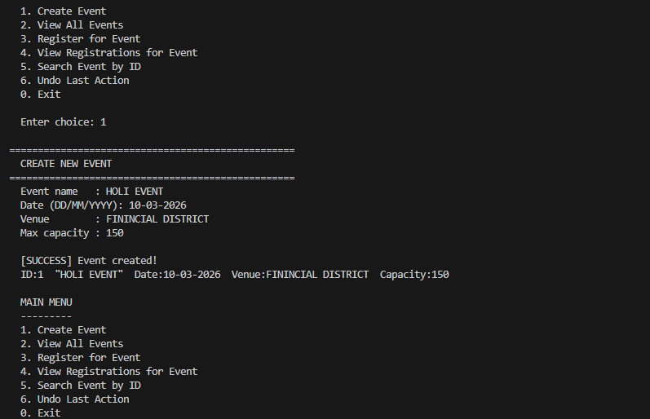
Screenshots for DSA
OUTPUT:

Slide 19
Conclusion
CommunitySync provides a modern digital solution to improve community engagement and collaboration. By integrating communication, event management, content sharing, and feedback collection into a single platform, it simplifies how communities interact and coordinate. The system promotes transparency, inclusivity, and active participation among members. With its scalable and secure architecture, CommunitySync can support communities of different sizes and needs. Overall, the platform contributes to stronger connections, better decision-making, and sustainable community development. It ultimately empowers communities to work together more effectively in the digital era.

Slide 20
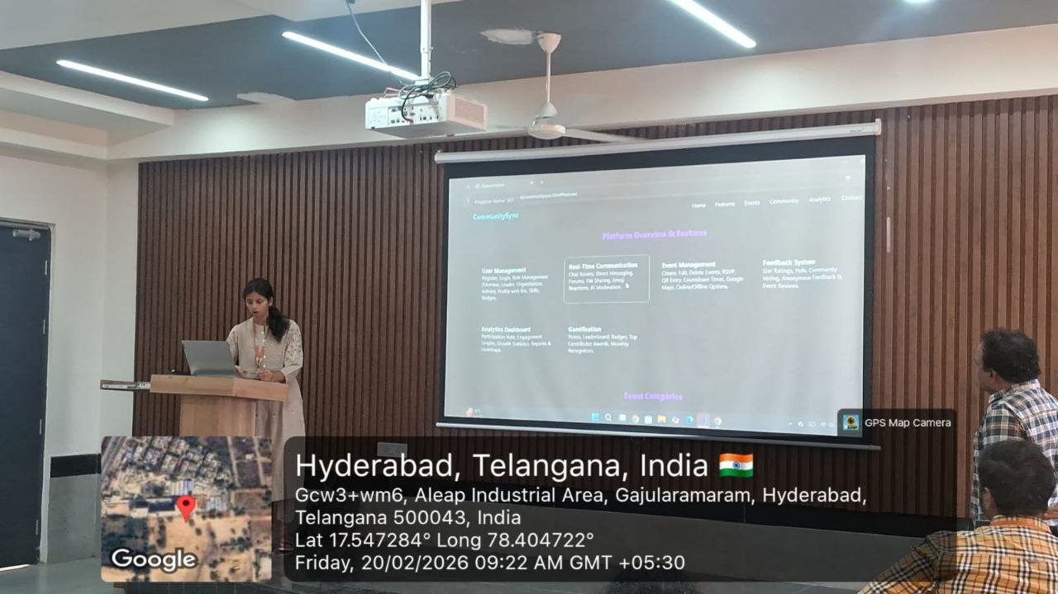
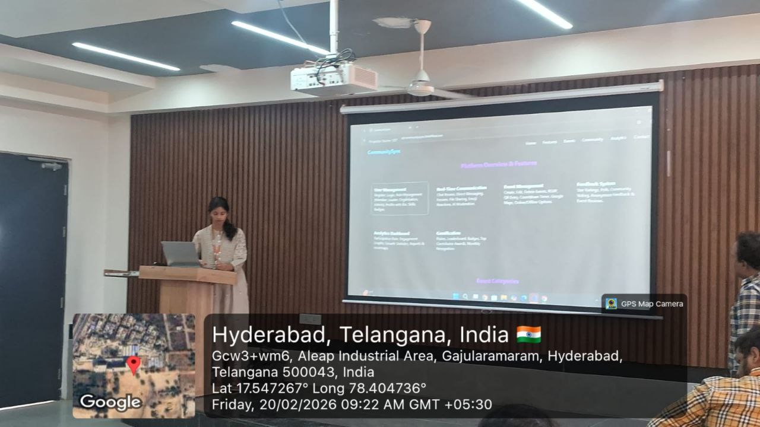
Geo- Tag Photos

Slide 21
THANK YOU

